Slide 1

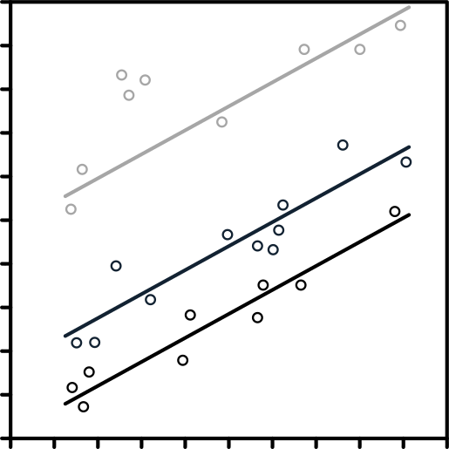
The Multivariable World
Multiple Regression
Mastering Complexity
Weaving Multiple Factors into a Unified Prediction
WEEK 8
01 / 30

Slide 2
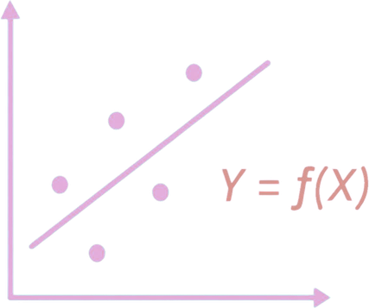
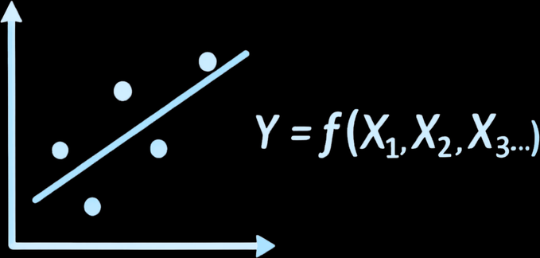
THE MULTI-FACTOR REALITY
Beyond the Single Thread
Single Regression
Multiple Regression
Y = f(X)
Y = f(X1, X2, X3...)
One predictor, one outcome
Multiple predictors, one outcome
Sales driven by ad spend alone
Sales = Ad Spend + Reps + Season + Price
Useful but incomplete
Models the whole story
02 / 30

Slide 3
THE MULTI-FACTOR REALITY
The Geometry of Multiple Dimensions
Simple regression finds a line through a 2D scatter plot
Multiple regression finds a plane slicing through a 3D cloud of data
Add more variables and the plane becomes a hyper-plane, impossible to draw, but still just math
The model still asks the same question: what flat surface fits the data best?
Visualization changes. The logic doesn't.
03 / 30

Slide 4

THE EQUATION
The Multiple Regression Equation
Y = a + b1*X1 + b2*X2 + b3*X3 + ...
Each 'b' coefficient is the specific weight of that one factor
b1 = 5.0 vs b2 = 0.2, X1 is a far more powerful lever than X2
Ceteris Paribus: each coefficient holds all other variables constant
We isolate the effect of one factor while the rest of the world stays frozen
This is how we untangle the causes, one thread at a time
04 / 30

Slide 5
OCCAM'S RAZOR
Model Parsimony: Less Is More
Adding 50 variables doesn't make a model smarter, it makes it fragile
Every extra variable adds noise. Complex models break when new data arrives.
A model with 3 strong variables beats a model with 20 weak ones every time
The goal: find the minimum set of variables that explain the maximum variation
Simple models that survive new data are more valuable than perfect models that don't
05 / 30

Slide 6

SECTION 2
The Logic of Refinement
Choosing the right variables and trusting the right metrics
06 / 30

Slide 7
THE HONEST METRIC
R² vs. Adjusted R²
Standard R²
Adjusted R²
Always goes up with more variables
Only goes up if the variable helps
Even useless variables improve it
Penalizes unnecessary complexity
Flatters the model
The honest quality score
The metric that can lie
Use this for all multi-variable models
07 / 30

Slide 8
THE DUPLICATE DANGER
Multicollinearity: The Duplicate Danger
When two independent variables are too highly correlated with each other
Total Website Traffic and Unique Visitors tell the same story, don't include both
The math gets confused: which variable gets the credit when they always move together?
Symptoms: coefficients flip signs, standard errors balloon, results change randomly
Rule: if two X variables correlate > 0.80, drop the weaker one before running the model
08 / 30

Slide 9
DIAGNOSTICS
The Correlation Matrix:
Map Before You Model
Before running regression, build a correlation map of all your X variables
A heat map shows every pairwise correlation at a glance
Dark cells = high correlation = potential multicollinearity problem
In Excel: Data > Data Analysis > Correlation -- select all X columns
This one step prevents the most common mistake in multiple regression
09 / 30

Slide 10
QUALITATIVE VARIABLES
Dummy Variables: Adding Text to Math
Regression requires numbers, but business data is full of categories
A dummy variable converts a category into 0 or 1
Dubai = 1, Abu Dhabi = 0. Now 'Location' is a number the model can use.
Rule: for a category with N groups, create N-1 dummy variables
The last group becomes the 'reference', everything is measured against it
This bridges qualitative insight and quantitative prediction
10 / 30

Slide 11
VARIABLE SELECTION
Variable Selection: The P-Value Audit
After running regression, check the p-value for each individual variable
P > 0.05 = the variable is not contributing real signal, it is noise
Remove the most insignificant variable, re-run the model, repeat
This iterative carving process is how a raw block of data becomes a masterpiece
Always re-check Adjusted R² after each removal, it should hold or improve
11 / 30

Slide 12
MODEL-LEVEL TESTING
The F-Test: Does the Team Win?
Individual p-values test each variable. The F-test tests the entire model.
Significance F < 0.05 = the combination of all your variables is better than guessing the average
A variable might look good alone but drag the team down, the F-test reveals this
Think of it as the coach evaluating the full lineup, not individual players
Always check Significance F before reporting any multi-variable model
12 / 30

Slide 13
CASE STUDY
Predict Employee Productivity
You have four potential predictors. Which has the lowest p-value?
[P-value?]
[P-value?]
[P-value?]
Hours Slept
Coffee Drunk
Office Temp
Fatigue reduces
focus and output.
Biological signal.
Correlated with
fatigue. May not
add independently.
Comfort matters
but varies widely.
Weak or strong?
13 / 30

Slide 14

SECTION 3
Diagnostics & Overfitting
Proving the model works on data it has never seen before
14 / 30

Slide 15
MODEL DIAGNOSTICS
Residual Analysis: The Model's Conscience
Plot your errors (residuals) against your predicted values after running regression
Random scatter = good model. Your errors are evenly distributed, no hidden patterns.
A U-shaped or fan-shaped pattern = the model is biased, it is missing something
Clustered errors in one range = the model performs well sometimes and badly other times
Never trust a model whose residuals you haven't examined
15 / 30

Slide 16
OVERFITTING
Overfitting: Fitting the Noise
A model that predicts 2024 data perfectly is suspicious, not impressive
Overfitting: the model memorizes the specific accidents of the training data
Result: perfect performance on historical data, catastrophic failure on new data
Adding variables without theory or logic is how overfitting starts
The test: does it still work on data it has never seen before?
16 / 30

Slide 17
VALIDATION
Validating with New Data
Training Set (80%)
Test Set (20%)
Build the model here
Never touched during training
Find coefficients and R²
Run predictions on new rows
Optimize on this data
Compare predicted vs. actual
The model has 'seen' this
True measure of model quality
17 / 30

Slide 18
THE SO WHAT
Interpreting Coefficients
Each coefficient is a rate of change holding all other variables constant
Coefficient of -500 for Price: for every $1 increase in price, we lose 500 units in sales
Ceteris Paribus, this is true while ad spend, season, and location stay the same
A positive coefficient means that variable is an accelerator, push it to grow Y
A negative coefficient means it is a drag, manage it carefully or reduce it
18 / 30

Slide 19
AUTOMATION
Stepwise Regression: The Automated Way
The computer adds or removes variables automatically based on statistical criteria
Forward selection: starts empty, adds the best variable one at a time
Backward elimination: starts full, removes the worst variable one at a time
Warning: the computer has no business logic, it will include absurd predictors if they fit
Stepwise gives you a starting point, human judgment provides the final decision
19 / 30

Slide 20
EXCEL PRO MODE
Reading the ToolPak Regression Output
Data > Data Analysis > Regression. Multiple X Range: select all predictor columns.
Focus on three numbers: Adjusted R-Square, Significance F, and each variable's P-value
Coefficients column = your equation. Standard Error column = precision of each estimate.
Significance F is the model-level p-value. Must be < 0.05 before trusting anything else.
The output table is dense, translate every number into a business sentence
20 / 30

Slide 21
APPLIED MODEL
Building the What-If Calculator
Take the coefficients from the output table and build an input dashboard
=Intercept + (b1 * Input_X1) + (b2 * Input_X2) + (b3 * Input_X3)
A manager types in their planned spend levels, the cell shows the predicted profit instantly
Change one input and every downstream prediction updates live
This is how analytics stops being a report and starts being a decision tool
21 / 30

Slide 22
CASE STUDY
Real Estate Appraiser Model
Predict House Price using three predictors. What do the signs tell you?
b = +350
b = varies
b = +12,000
Size (sqft)
Age (years)
Location Score
Positive: each
extra square foot
adds $350 in value.
Newer = cheaper
but very old =
premium. Non-linear?
Biggest lever.
Location dwarfs
size and age.
22 / 30

Slide 23

SECTION 4
The Professional Finish
Ethics, communication, and the analyst's final responsibility
23 / 30

Slide 24
COMMUNICATION
Communicating Complexity
to Non-Data People
Don't Show
Do Say
Y = 4200 + 5.0*X1 + 0.2*X2
Our model explains 83% of revenue variation
Adjusted R² = 0.83
Customer service speed is 3x more powerful than price discounts
Significance F = 0.0002
These three factors reliably predict next quarter's outcome
All the coefficients table
Here is the what-if calculator, you drive it
24 / 30

Slide 25
ETHICS
The Ethics of Algorithmic Bias
Including 'Zip Code' as a variable can accidentally encode racial or income discrimination
The math doesn't know what the variable represents, the human is responsible
A model that perpetuates historical inequality is not a neutral tool, it is a weapon
Before including any variable, ask: is this a proxy for a protected characteristic?
You are responsible for the moral logic of your model, not just the statistical logic
25 / 30

Slide 26
TRANSPARENCY
The Black Box Problem
If you cannot explain why a variable is in the model, take it out
A model with unexplainable inputs will eventually produce unexplainable outputs
Stakeholders don't trust what they can't understand, and they shouldn't
Transparency is not a nicety, it is the foundation of trust in data-driven decisions
The best model is the one the organization will actually use and scrutinize
26 / 30

Slide 27
SECTION 4 • THE FULL JOURNEY
Course 1: The Full Data Professional Lineage
1
2
3
Weeks 1-2
Weeks 3-5
Weeks 6-8
>
>
KPIs and
Visualization.
What happened?
Logic, Governance,
and Cleaning.
Is the data right?
Stats, Regression,
and Prediction.
What will happen?
27 / 30

Slide 28
“
Be confident in your math.
Be humble about the future.
Always show the interval, never just the number.
Soft Skill: Confidence vs. Humility
28 / 30

Slide 29
SUMMARY
What We Covered This Week
Multiple regression: isolating the effect of each variable while holding others constant
Adjusted R² is the honest metric. Multicollinearity is the hidden enemy.
P-value audit: carve the model down to only the variables that earn their place
Hold-out testing, residual analysis, and ethical variable selection complete the professional picture
29 / 30

Slide 30

Let's Talk.
The world is a very big place.
But it is a place that can be modeled.
Final Project: Use everything from Week 1 to Week 8 to solve a single business problem.
You now have the full toolkit of a data professional.
30 / 30

